Slide 1
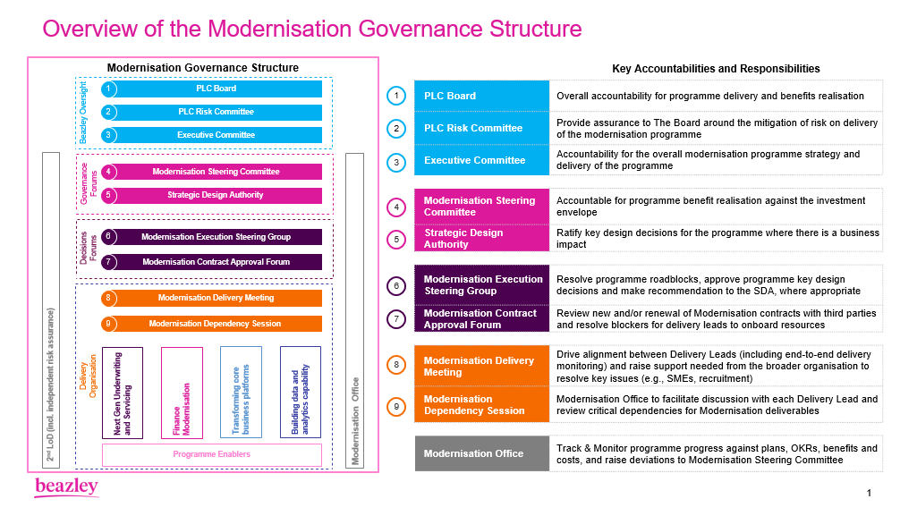

Slide 2



GPAS & BILLING – DRAFT STRUCTURE v0.2
Risk Board
(see previous slide)
Other Programme Stakeholders
Key:
Capgemini
Key Cross-Programme Delivery Support
Beazley
Product Rationalis-ation
Jeff Colandrea
(Platform Owner)
Devin Wells
(Policy SME)
Matt Reynolds
(Bus. Architecture)
Peter Dixon
(Prod Rationalisation)
Guidewire
Modernisation Steering Group
See previous Slide)
TBC TBC TBC
US Based
Abby
Vredenburg
(Bus Proc PO)
Steve Flood
(Claims SME)
Troy Baillargeon (Prod Rationalisation)
Kelly Reisling
(Prod Rationalisation)
Executive Leadership
Akhlas Hafiz
(Head of Modernisation)
Vanessa Ortega (Business Owner)
Ben Lowles
(Procurement Lead)
Canada Based
TBD
(Prod Rationalis’n BA)
TBD
(Data Team Reps)
TBD
(Prod Rationalis’n BA)
India Based
Dauda Jammeh
(Bus Owner - Finance)
Barry Houston
(Delivery Exec)
Ian Craney
(Procurement Lead)
Process Excellence
Abby
Vredenburg
(Bus Proc PO)
Saad Jassani
(Process SME)
Kerstin Kasdorf
(Process SME)
Subu Ramasundaram
(Process SME)
Stephan Benet-Weiler / Aine Kane (Del Exec)
Infra / DevOps
Simon Fry
(Infrastructure)
TBC
(DevOps)
TBD
(DevOps)
Program Leadership
Warren Pilkington (Prog Director)
TBC
(Lead GPAS PO)
Stephen Payne
(Del Lead – GPAS & Billing)
Owen Humphries
(Technical Lead)
Dean Johnston
(Ent Architecture)
Jeff Colandrea
(Platform Owner)
Business Analysis
Alejandro Gonzalvez Suarez (BA)
Dominik Dyszkowski
(BA)
TBD
(Process Design BA)
Max Cartwright
(Prog Director)
TBC
(Lead Finance PO)
Athik Miah
(Del Lead - Billing)
Natraj Gudla
(Del lead – India)
Danny Sohal
(Finance Architect)
Anita Param
(Migration BA)
Andy Ford
(Migration BA)
TBC
(Prod Rational^{n} BA)
TBC
(Functional Lead)
Ananda A Ponnaiah
(Del Lead UK)
Frederic Brunner
(Delivery Director)
Brett Fabian-Smith
(Ent Architect)
SMEs
Devin Wells
(Policy SME)
Steve Enness
(Prod Rationalisation)
Carol Hamilton
(Credit Control NA)
TBC
(UW SMEs)
TBC
(GW Ent Architect)
Steve Flood
(Claims SME)
Troy Baillargeon (Prod Rationalisation)
Molly Spolarich
(Operations SME)
POs, Functional & Technical Leads
Kerstin Kasdorf
(Policy PO)
Patrycja Kuligowska
(Billing PO)
TBD
(Integration Lead)
TBD
(Data Lead)
TBD
(Docs Lead)
TBD
(Migration Lead)
TBD (Hexaware)
(Test Mgr)
TBD (Training / Bus Readiness Lead)
Current Plat. Owners
Jeff Colandrea
(BeazleyPro)
Mark Parlsey
(TBC)
Devin Wells
(TBC)
Antonia Seager
(Finance)
Sherezad Contractor
(PC Func Ld)
Sriram Jagannathan
(BC Func Ld)
Gourab Marikm
(GW Int. Lead)
TBD
(Policy Mig’n Lead)
SivaramaKrishna Narayanan
(Test Manager)
Architects
Matt Reynolds
(Bus Arch)
TBD
(Solution Architect)
TBC (GW Assurance Architect)
Rajesh Bandaru
(PC Tech Ld)
Balaji KV
(BC Technical Lead)
Vamshi C
(Guidewire Lead)
Marta Latuszek
(Fin Architect)
Jigar Solanki
(Solution Architect)
TBD
(GW PC Lead)
TBD
(GW BC Lead)
TBD
(GW Int Lead)
Shared Services
TBD
(IT Security)
TBD
(Risk)
PAS BAU transition (based on ITOM/BAU Serv Mgmnt Structure)
Delivery Teams (see over)
TBD
(Audit)
TBD
(Compliance)

Slide 3
GPAS & BILLING – DRAFT STRUCTURE (INC DEVELOPMENT) v0.2
Executive Leadership
Product Rationalis-ation
Program Leadership
POs, Functional & Technical Leads
Process Excellence
Delivery Teams
Foundation Release
(High Level)
Policy Lead
Billing Lead
Integration Lead
Data Lead
Docs Lead
Migration Lead
Testing Lead
Training & Business Readiness
Infra / DevOps
Product Owner
Business SMEs
Business Analysts
Scrum Master
Dev Lead
Developers
GW Consultants
Business Analyst
Tech Lead
Developers
Testers
Business Analysts
Product Owner
Business SMEs
Developers
GW Consultants
Business Analyst
Tech Lead
Developers
Testers
Technical SMEs
Developers
GW Consultants
Business / Mapping Analyst
Tech Lead
Developers
Testers
Product Owner
Business SMEs
Technical SMEs
Business / Data Analyst
Data Developers
Testers
Product Owner
Business SMEs
Technical SMEs
Business / Docs Analyst
Docs Developers
Testers
Product Owner
Business SMEs
Technical SMEs
Business / Migration Analyst
Migration Developers
Testers
UAT Testers
SIT Testers
Business Readiness Lead
Training and Communication Lead
Model Office Lead
Business Analysis
UK
SMEs
India
Current Plat. Owners
Architects
Automation Testers
Shared Services
Key:
Capgemini
Beazley
Combined Teams
Guidewire

